Slide 1
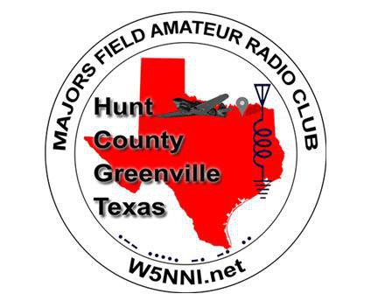
Majors
Field
Amateur
Radio
Club
Membership Meeting
FEBRUARY 8, 2024

Slide 2
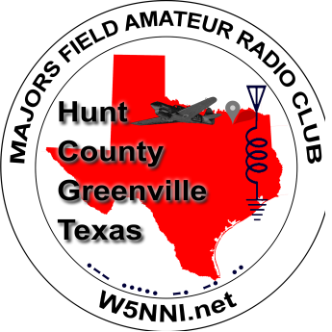

Agenda
•
•
•
•
•
•
Officers for 2024
Officer Reports
Calendar of Events
New/Old Business
Program
Adjournment
& Announcements

Slide 3
Current Officers
•
PRESIDENT
Larry Smith – K5XB
•
VICE-PRESIDENT
Shawn Crossland – N6REP
•
SECRETARY
Scott Davis – KK7JS
TREASURER
•
Scott Joseph – AG5QQ
•
TRUSTEE (appointed)
Jonathan Brown – WB5KSD
•
ACTIVITIES (appointed)
David Rogers – KG5KPU

Slide 4
Officer Reports
•
SECRETARY’S REPORT
•
MEETING MINUTES
•
TREASURER’S REPORT
•
BANK BALANCE
•
ACTIVITIES REPORT
•
VARIOUS TOPICS
•
PRESIDENT’S REPORT
•
VARIOUS TOPICS

Slide 5
Calendar of Events &
Announcements
Rains ARA Meeting Saturday, Feb 10th, Emory VFD at 9 AM
Combined Rains/Hopkins County Net Mondays 7:30 PM 146.92(-)
(88.5Hz) 10 Meter Net 28.430 Mondays 8:00 PM
•
•
SVARA Feb
15th
at 7 PM Hunt Regional Hospital, Greenville
2nd floor conference room
•
Hopkins ARC Meeting Feb
15th
at 7 PM, First Church of the
Nazarene, Sulphur Springs
•
Next Majors Field ARC Meeting Mar 14th at 11:45 AM on Zoom, Weekly net Tues 11:45 AM 147.16(+)(100Hz)

Slide 6
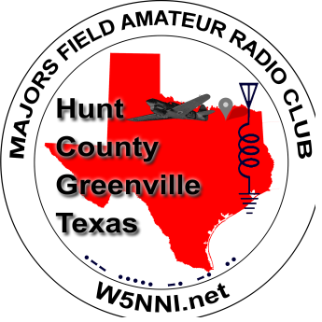
Hamfest
Calendar
•
Upcoming Jan / Feb / Mar:
•
Orlando HamCation, Feb 9-11, Orlando, FL www.hamcation.com
Irving ARC Hamfest, Mar 2, Irving, TX http://irvingarc.org
Greater Houston Hamfest & West Gulf Div Convention, Mar 1-2, Rosenberg, TX https://houstonhamfest.org/
St. Patrick’s Day Hamfest, Mar 16, Midland, TX
http://hamfest.w5qgg.org
•
•
•
•
Long Range Planning
•
•
•
•
Belton Ham EXPO, Apr 12-13, Belton, TX www.tarc.org/hamexpo
Emory Hamfest, Apr 27, Emory, TX http://w5ent.org
Dayton HamVention, May 17-18-19, Xenia, OH www.hamvention.org
San Antonio Radio Fiesta, Jul 19-20, Schertz, TX,
http://w5sc.org
Texoma Hamarama, Oct 26 https://hamarama.org
•

Slide 7

Hamfest
Calendar

Slide 8
Old Business
•
N5SN status – there is continuing need to restore the link
• Yes?
No? -- Answer is Yes. Jon to continue efforts.
•
W5NNI repeater status (update by N6REP during program time)
• Working OK?
Shack Temperature?
Upgrades?
•
•
•
Solar Eclipse Project at Rec Hall April 8 (David KG5KPU will update by email this week.)
Parks on the Air (POTA) April 20 Cooper Lake State Park
ARRL Issues -- update to come later this month.

Slide 9
New Business
•
•
•
Help for Civil Air Patrol Communications
Morse Code Classes (Possible Lunch & Learn)
Field Day efforts
Skywarn Classes – Classroom and On-line sessions
https://www.weather.gov/fwd/skywarnmap
•

Slide 10
New Business
•
Skywarn Classes – Classroom sessions
Van Zandt | Monday, February 12th | In Person | 6:00 pm | Sarah Norman Library (Canton)
Van Zandt | Monday, February 12th | In Person | 6:00 pm | Sarah Norman Library (Canton)
Kaufman | Tuesday, February 13th | In Person | 7:00 pm | Kaufman Civic Center
Hopkins | Tuesday, February 27th | In Person | 6:00 pm | Sulphur Springs City Hall
•
Skywarn Classes – On-line sessions
NWS SKYWARN - Basic | Monday, February 26th | Virtual | 7:00 pm | Virtual
NWS SKYWARN - Advanced | Wednesday, February 28th | Virtual | 7:00 pm | Virtual

Slide 11
Wrap-Up
•
•
•
•
•
Go Backs?
Do Overs?
Second Guesses?
I Wish I Had Said…
I Just Remembered…

Slide 12
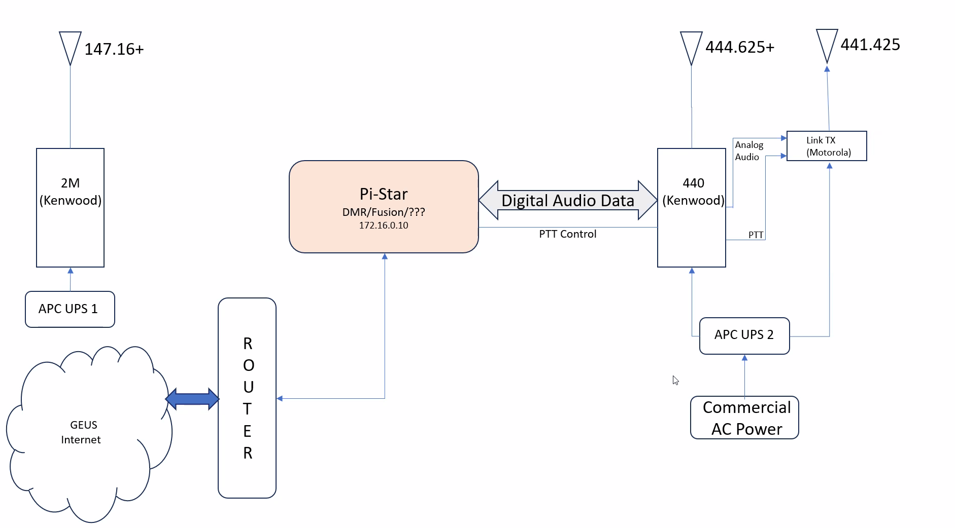
Program
Potential Repeater Upgrades
From: Shawn – N6REP

Slide 13
Adjournment
See You Next Month!

Slide 14
David’s post-meeting Activities Report
Solar Eclipse, Monday, April 8th:
I am working with Facilities, MSTF, Security and a myriad of other company entities to get permission to set up a portable HF station here on plant. I have requested we be allowed to use the area behind buildings 106/121 and where security kennels their dogs. The other option is to set up at the Rec Center. So far, we have received a green light from MSTF and the freq spectrum manager. Now, it is a matter of getting permission to set it up. As you can imagine, there are several hurdles to jump over and hoops to jump through. If we do get permission, the plan is to participate in the ARRL Global Experiment. We would transit from the beginning of the eclipse, through total darkness, and on to when the event is completely over -about 2 hours, total. Then, we’d submit our logs to the ARRL so they can study how an eclipse impacts HF propagation. The station would be an Octopus antenna on a 20ft mast, attached to the receiver hitch of my truck (you’ve seen the set up in my weekend antenna experiments, and Cooper Lake trips)., connected to an IC7100 running off of battery power
(2ea 30aH LiPo batteries, in parallel). I’ll have a sunscreen shelter and a folding table with 3
chairs set up, as well.
I shall keep y’all posted.
Texas Parks on the Air:
April 20th.
Larry and I each have a cabin rented at our usual hang out…Cooper Lake, South Sulphur Unit. We will be using 1x1 call N5C, though individuals are welcome to use their personal call signs while operating with us.
I’ll have more details as we get closer to the event.

Slide 15
David’s post-meeting Activities Report
Texas Parks on the Air:
April 20th.
Larry and I each have a cabin rented at our usual hang out…Cooper Lake, South Sulphur Unit. We will be using 1x1 call N5C, though individuals are welcome to use their personal call signs while operating with us.
I’ll have more details as we get closer to the event.

